Slide 1

University Admission System (UAS)
Group No. 6
Mentor
Yogini Naik

Slide 2
PROJECT UNDERSTANDING
The main objective of this project is to design and develop a University Admission System.
University Admission System is used to apply for online courses.
This is an integrated system that contains the applicant component, admin component and mac component.

Slide 3
Index
Requirement Understanding
Use-Case Diagram
Modules
Learning
Future Aspects

Slide 4
Requirement Understanding
The users are classified into three types:
Applicant
Can view/apply programs scheduled.
View the application status, based on the application ID.
Member Of Admission Committee (mac)
Can Login into the system.
View applications for a specific program.
Accept/Reject an application.
Update the status of the application.

Slide 5
Requirement Understanding
Admin
Login to the system.
Update and manage (add or delete) information of the programs.
Manage (add or delete) schedules of the programs offered.
Generate various reports like:
View List of applicants confirmed/ accepted (waiting for interview)/rejected for a scheduled program.
View list of programs scheduled to commence in a given time period.

Slide 6
Applicant UseCase

Slide 7
Admin UseCase

Slide 8
MAC UseCase

Slide 9
Modules
Login verification.
Retrieve Programs Scheduled.
Apply Online.
Retrieve Application Status.
Retrieve Applications for Scheduled Program.
Filter Applicants.
View Programs Offered/Scheduled to Commence in a given time period.
View list of applications Accepted/Rejected/Confirmed for a particular Scheduled Program.

Slide 10
Modules
Retrieve Programs Scheduled Module
The applicant can view all programs scheduled by the university.
Apply Online Module:
Applicant can submit his/her application for a scheduled program only after performing obvious validations on the entered data.
An application ID is auto generated.

Slide 11
Modules
Retrieve Application Status Module:
This module can be used by the applicant.
Status is displayed as per the applicant’s Id(if found).

Slide 12
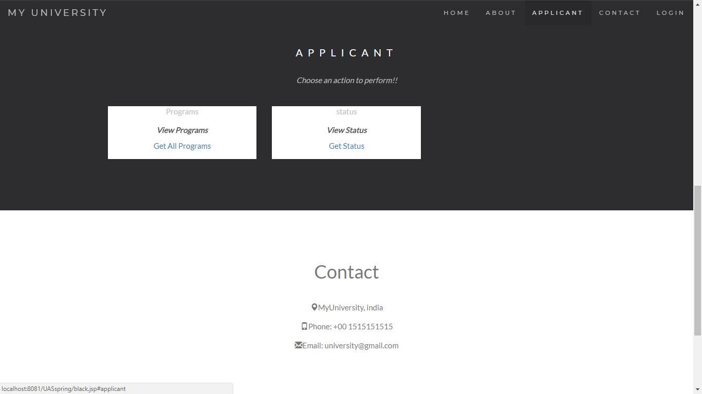
Applicant Home Page

Slide 13
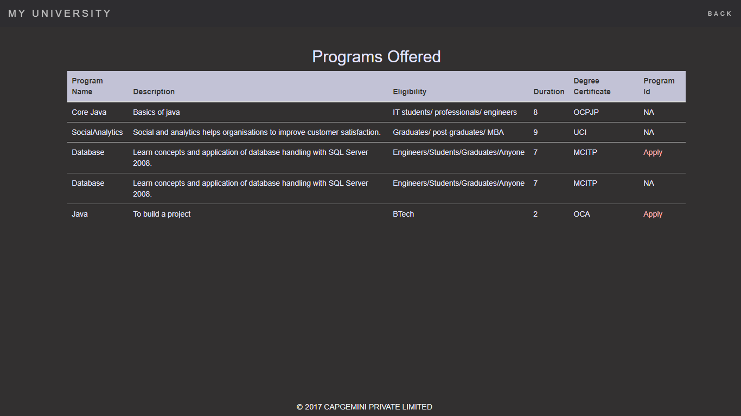
Apply For A Program

Slide 14
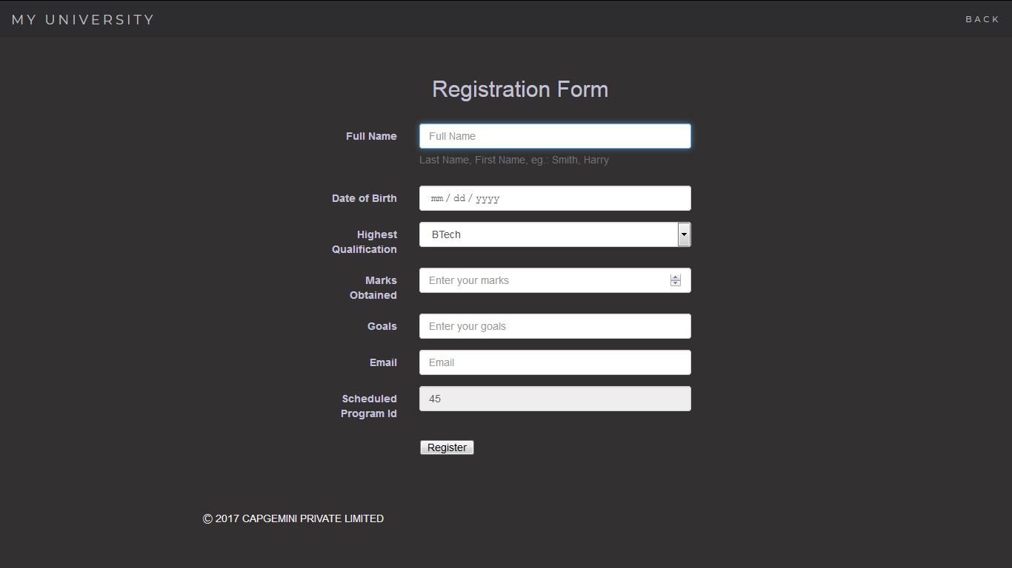
Registration Form

Slide 15
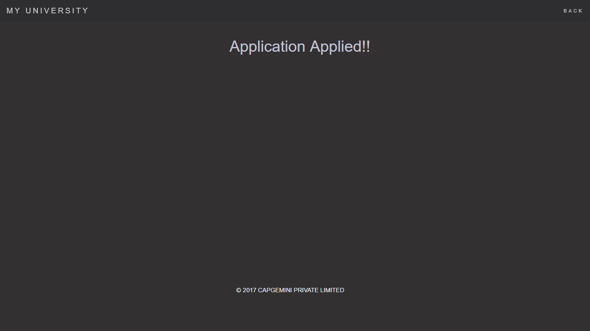
After Applicant Successfully Applied

Slide 16
Modules
Login Module:
Login module is common for Admin, MAC
Basic functionality of module are as follows:
Taking login credentials from the user.
If given credentials are wrong, show appropriate message.
If login succeeds, user will be navigated to his/her respective page as per his/her role.

Slide 17
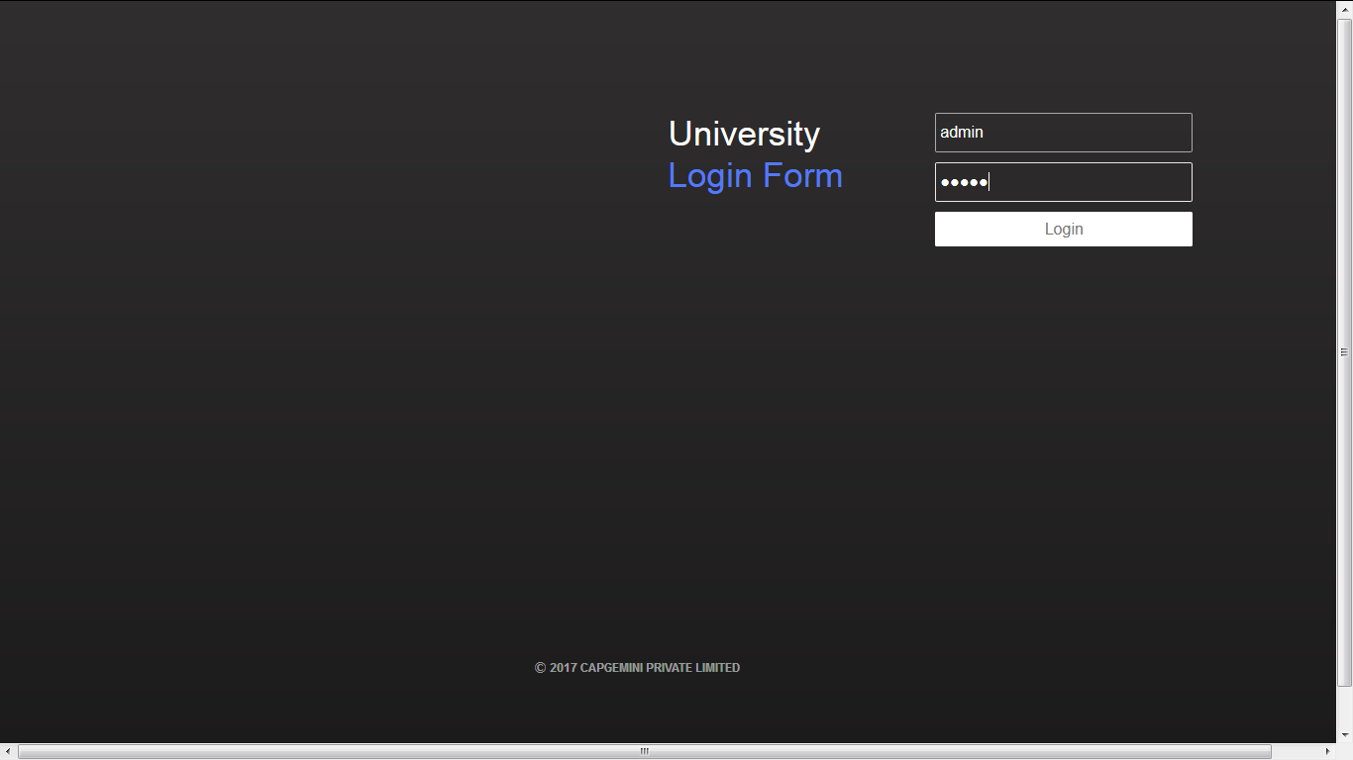
Login Page

Slide 18
Modules
Maintain Program Information Module:
This module can be used by an authorized admin only.
Admin maintains information includes :
Programs Offered (add/update/delete) and
Programs Scheduled (add).

Slide 19
Modules
View information of Programs Scheduled to Commence in a
given time period Module:
Used by Admin to retrieve details of programs scheduled that are commenced within the given time period.

Slide 20
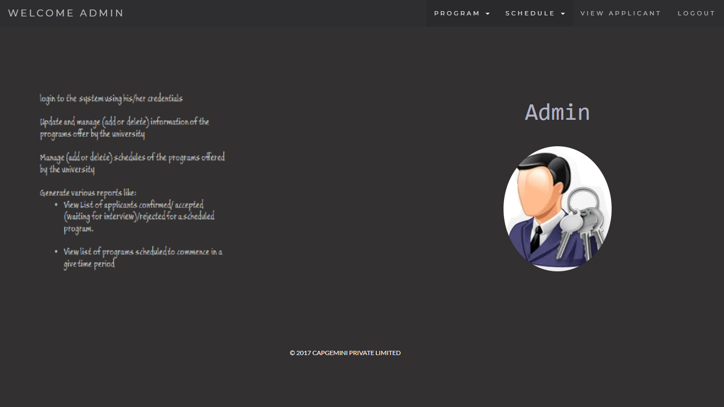
Admin Home Page

Slide 21
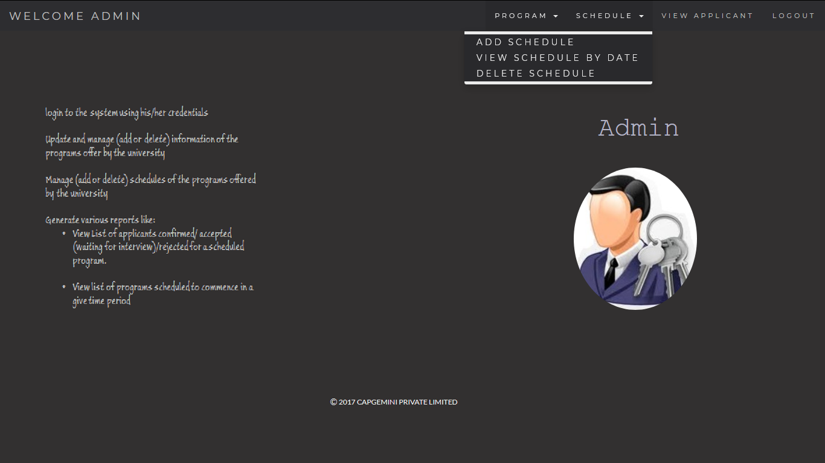

Slide 22
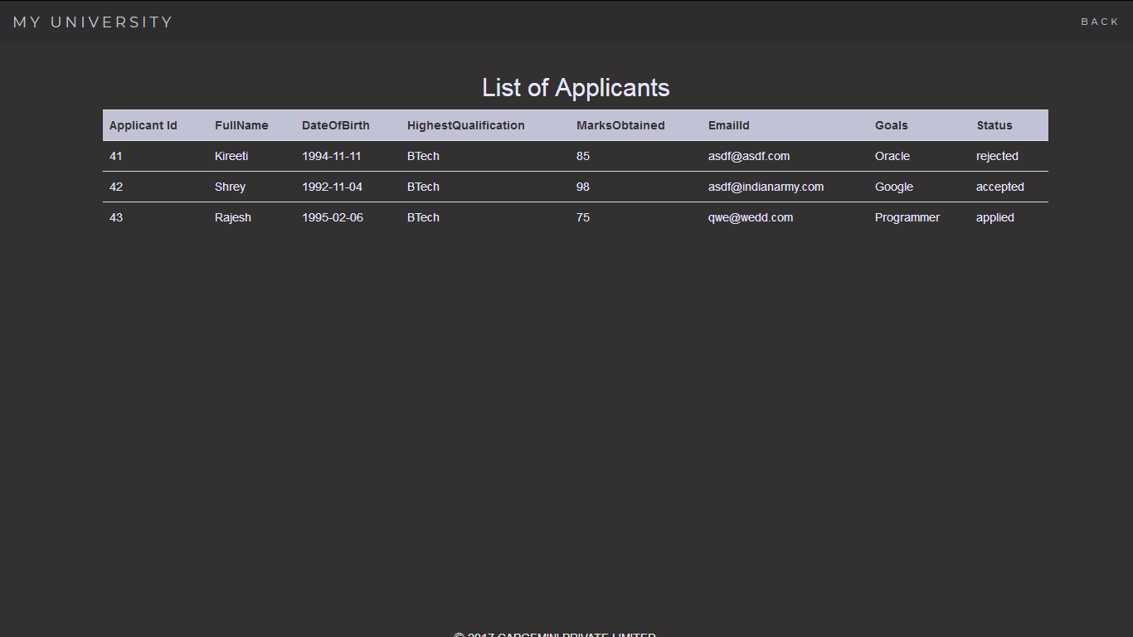

Slide 23
Modules
Retrieve Applications for Scheduled Program Module
This module can be used by an authorized MAC.
Can view all the applicant data, based on Scheduled Program id.

Slide 24
Modules
Filter Applicants Module
This module can be used by an authorized MAC.
Can Accept/Reject the application, if accepted, the applicant is scheduled a date of interview.

Slide 25
Modules
View list of applications
Accepted/Rejected/Confirmed for a particular Scheduled
Program :
Available to Mac only, can update the status of applicants to confirmed or rejected.

Slide 26
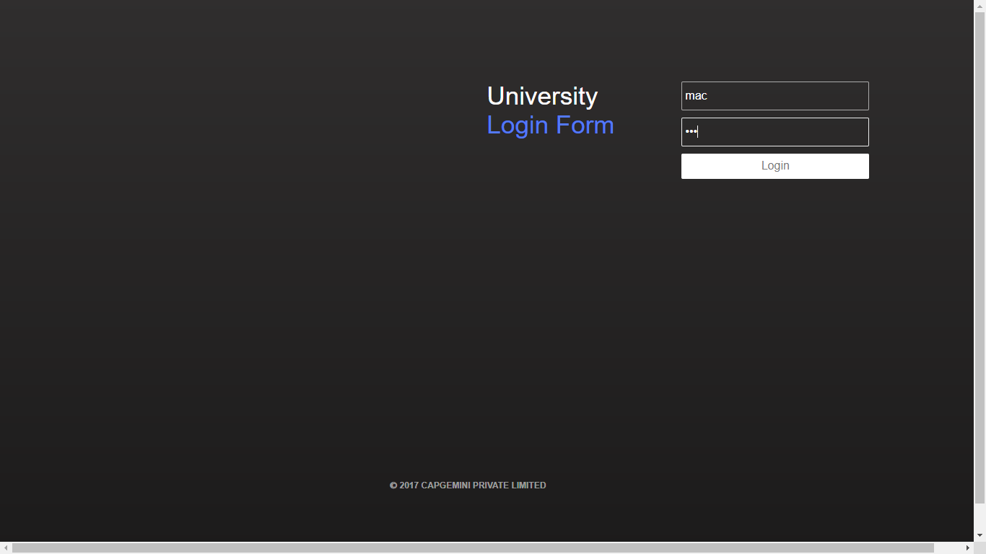
Login Page

Slide 27
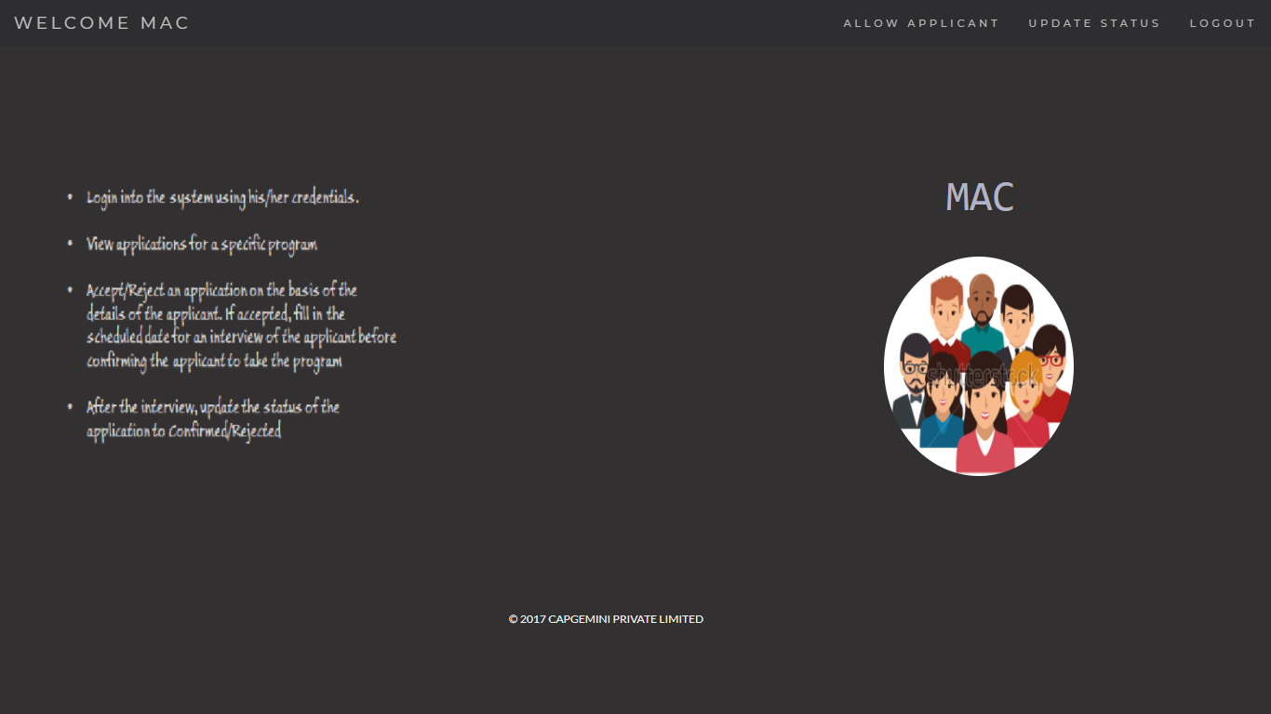
MAC Home Page

Slide 28
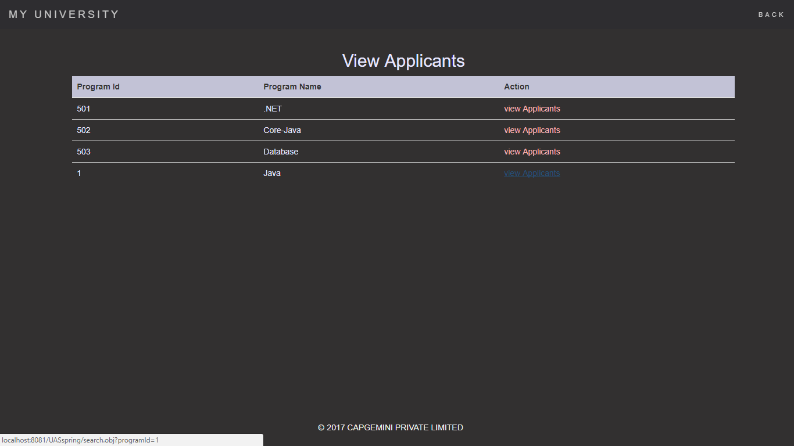
View Applicants MAC

Slide 29
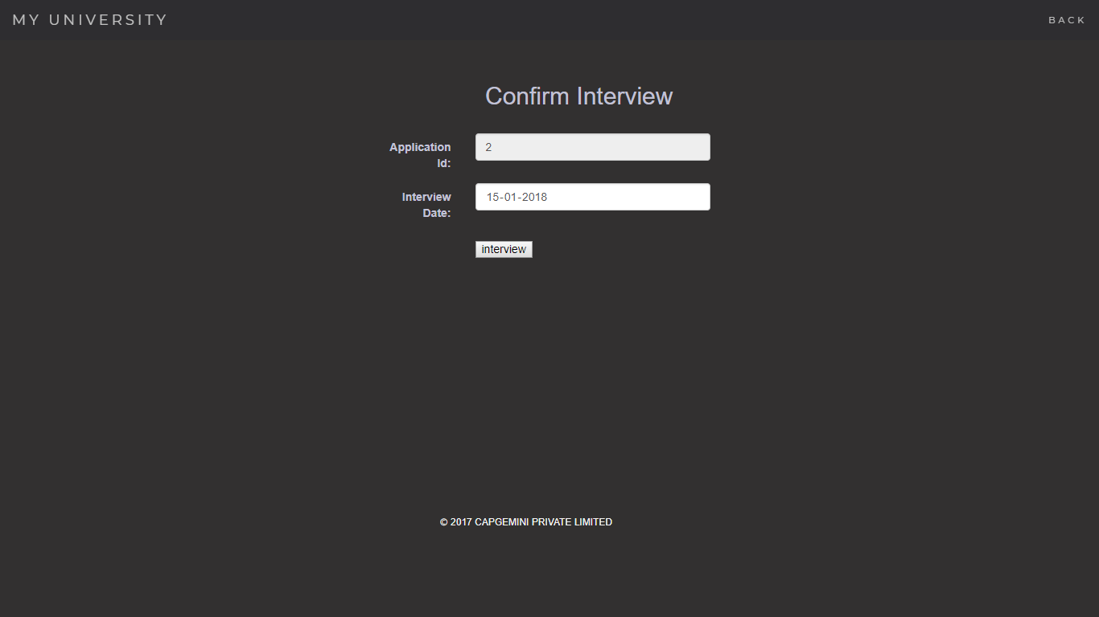
Interview Date Assign

Slide 30
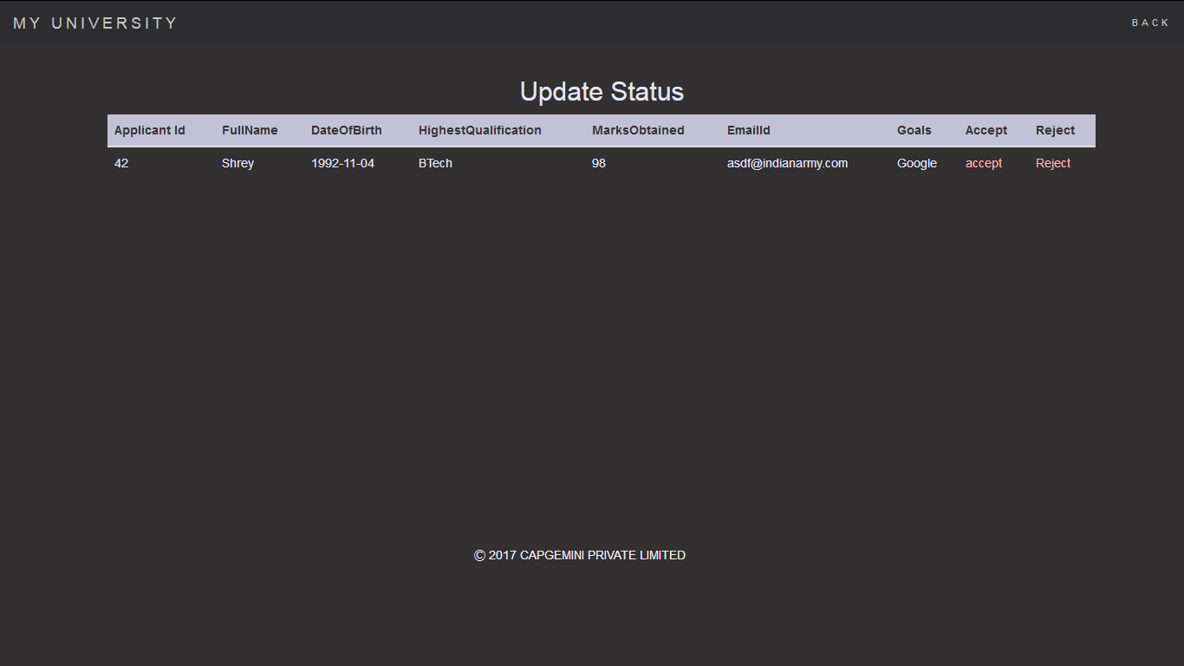
Update Status

Slide 31
LEARNING
We have implemented the project University Admission System, using Spring framework with JPA and JSP.
Time Management and division of work.

Slide 32
Future Aspects
We can include Online Fee Payment for convenience of the applicants.
We can include feed back system from applicant’s point of view.
We can introduce Bulletin Boards in the website to share information regarding any schedule delays or special courses.

Slide 33

Any Questions?

